Slide 1

WKES 3202 Software Requirements Engineering

Slide 2

Explain the importance of requirements management
Explain reasons of requirements change

Slide 3

The process of managing change to the requirements for a system
The principal concerns of requirements management are:
  Managing changes to agreed requirements
  Managing the relationships between requirements
  Managing the dependencies between the requirements document and other documents produced in the systems engineering process
Requirements cannot be managed effectively without requirements traceability.
  A requirement is traceable if you can discover
    who suggested the requirement,
    why the requirement exists,
    what requirements are related to it and
    how that requirement relates to other information such as systems designs, implementations and user documentation.

Slide 4

Requirements management involves the collection, storage and maintenance of large amounts of information
There are now a number of CASE tools available which are specifically designed to support requirements management
Other CASE tools such as configuration management systems may be adapted for requirements engineering

Slide 5

A database system for storing requirements.
Document analysis and generation facilities to help construct a requirements database and to help create requirements documents.
Change management facilities which help ensure that changes are properly assessed and costed.
Traceability facilities which help requirements engineers find dependencies between system requirements.

Slide 6

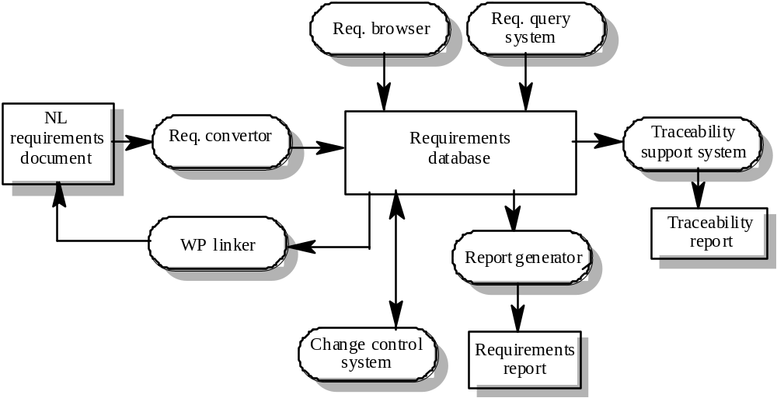

Slide 7
Requirements changes occur while the requirements are being elicited, analysed and validated and after the system has gone into service
Some requirements are usually more subject to change than others
  Stable requirements are concerned with the essence of a system and its application domain. They change more slowly than volatile requirements.
  Volatile requirements are specific to the instantiation of the system in a particular environment and for a particular customer.

Slide 8
Requirements errors, conflicts and inconsistencies
  As requirements are analysed and implemented, errors and inconsistencies emerge and must be corrected. These may be discovered during requirements analysis and validation or later in the development process.
Evolving customer/end-user knowledge of the system
  As requirements are developed, customers and end-users develop a better understanding of what they really require from a system.
Technical, schedule or cost problems
  Problems may be encountered in implementing a requirement. It may be too expensive or take too long to implement certain requirements.

Slide 9

Changing customer priorities
  Customer priorities change during system development as a result of a changing business environment, the emergence of new competitors, staff changes, etc.
Environmental changes
  The environment in which the system is to be installed may change so that the system requirements have to change to maintain compatibility
Organisational changes
  The organisation which intends to use the system may change its structure and processes resulting in new system requirements

Slide 10

Mutable requirements
  These are requirements which change because of changes to the environment in which the system is operating (law change)
Emergent requirements
  These are requirements which cannot be completely defined when the system is specified but which emerge as the system is designed and implemented
Consequential requirements
  These are requirements which are based on assumptions about how the system will be used. When the system is put into use, some of these assumptions will be wrong.
Compatibility requirements
  These are requirements which depend on other equipment or processes.

Slide 11

It is essential for requirements management that every requirement should have a unique identification
The most common approach is requirements numbering based on chapter/section in the requirements document
Problems with this are:
  Numbers cannot be unambiguously assigned until the document is complete
  Assigning chapter/section numbers is an implicit classification of the requirement. This can mislead readers of the document into thinking that the most important relationships are with requirements in the same section

Slide 12

Dynamic renumbering
  Some word processing systems allow for automatic renumbering of paragraphs and the inclusion of cross-references. As you re-organise your document and add new requirements, the system keeps track of the cross-reference and automatically renumbers your requirement depending on its chapter, section and position within the section
Database record identification
  When a requirement is identified it is entered in a requirements database and a database record identifier is assigned. This database identifier is used in all subsequent references to the requirement
Symbolic identification
  Requirements can be identified by giving them a symbolic name which is associated with the requirement itself. For example, EFF-1, EFF-2, EFF-3 may be used for requirements which relate to system efficiency

Slide 13

Requirements have to be stored in such a way that they can be accessed easily and related to other system requirements
Possible storage techniques are
  In one or more word processor files - requirements are stored in the requirements document
  In a specially designed requirements database

Slide 14
Advantages
  Requirements are all stored in the same place
  Requirements may be accessed by anyone with the right word processor
  It is easy to produce the final requirements document
Disadvantages
  Requirements dependencies must be externally maintained
  Search facilities are limited
  Not possible to link requirements with proposed requirements changes
  Not possible to have version control on individual requirements
  No automated navigation from one requirement to another

Slide 15

Each requirement is represented as one or more database entities
Database query language is used to access requirements
Advantages
  Good query and navigation facilities
  Support for change and version management
Disadvantages
  Readers may not have the software/skills to access the requirements database
  The link between the database and the requirements document must be maintained

Slide 16

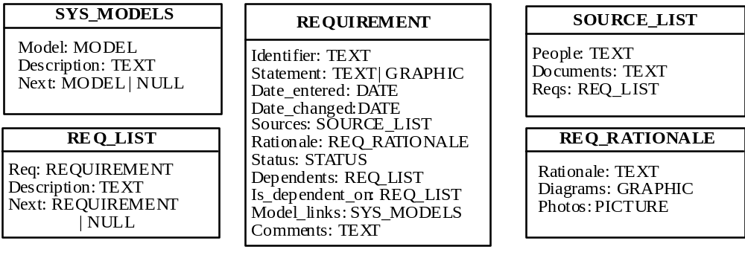

Slide 17

The statement of requirements
  If there is a need to store more than just simple text, a database with multimedia capabilities may have to be used.
The number of requirements
  Larger systems usually need a database which is designed to manage a very large volume of data running on a specialised database server.
Teamwork, team distribution and computer support
  If the requirements are developed by a distributed team of people, perhaps from different organisations, you need a database which provides for remote, multi-site access.

Slide 18

CASE tool use
  The database should be the same as or compatible with CASE tool databases. However, this can be a problem with some CASE tools which use their own proprietary database
Existing database usage
  If a database for software engineering support is already in use, this should be used for requirements management.

Slide 19

Change management is concerned with the procedures, processes and standards which are used to manage changes to system requirements
Change management policies may cover:
  The change request process and the information required to process each change request
  The process used to analyse the impact and costs of change and the associated traceability information
  The membership of the body which formally considers change requests
  The software support (if any) for the change control process

Slide 20

Some requirements problem is identified.
  This could come from an analysis of the requirements, new customer needs, or operational problems with the system. The requirements are analysed using problem information and requirements changes are proposed.
The proposed changes are analysed
  This checks how many requirements (and, if necessary, system components) are affected by the change and roughly how much it would cost, in both time and money, to make the change.
The change is implemented.
  A set of amendments to the requirements document or a new document version is produced. This should, of course, be validated using whatever normal quality checking procedures are used.

Slide 21

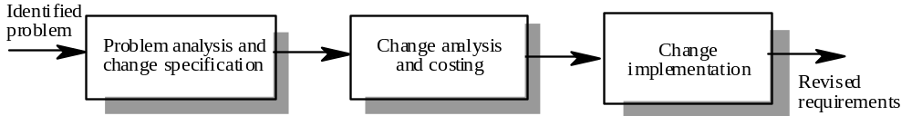

Slide 22

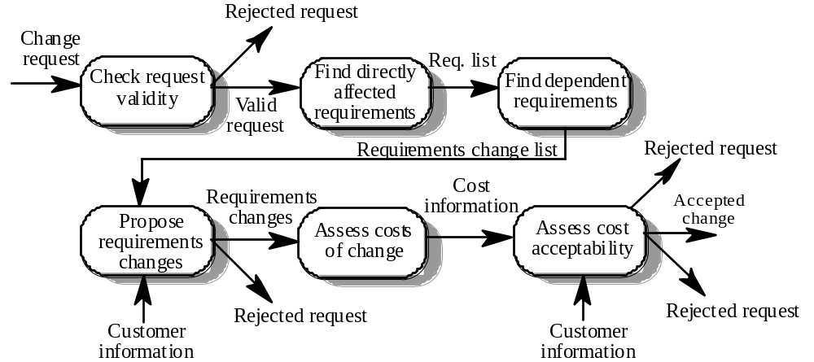

Slide 23
The change request is checked for validity. Customers can misunderstand requirements and suggest unnecessary changes.
The requirements which are directly affected by the change are discovered.
Traceability information is used to find dependent requirements affected by the change.
The actual changes which must be made to the requirements are proposed.
The costs of making the changes are estimated.
Negotiations with customers are held to check if the costs of the proposed changes are acceptable.

Slide 24
If the change request is invalid. This normally arises if a customer has misunderstood something about the requirements and proposed a change which isn’t necessary.
If the change request results in consequential changes which are unacceptable to the user.
If the cost of implementing the change is too high or takes too long.

Slide 25

Proposed changes are usually recorded on a change request form which is then passed to all of the people involved in the analysis of the change
Change request forms may include
  fields to document the change analysis
  data fields
  responsibility fields
  status field
  comments field

Slide 26

May be provided through requirements management tools or through configuration management tools
Tool facilities may include
  Electronic change request forms which are filled in by different participants in the process.
  A database to store and manage these forms.
  A change model which may be instantiated so that people responsible for one stage of the process know who is responsible for the next process activity.
  Electronic transfer of forms between people with different responsibilities and electronic mail notification when activities have been completed.
  In some cases, direct links to a requirements database.

Slide 27

Traceability information is information which helps you assess the impact of requirements change. It links related requirements and the requirements and other system representations
Types of traceability information
  Backward-from traceability Links requirements to their sources in other documents or people
  Forward-from traceability Links requirements to the design and implementation components
  Backward-to traceability Links design and implementation components backs to requirements
  Forward-to traceability Links other documents (which may have preceded the requirements document) to relevant requirements.

Slide 28

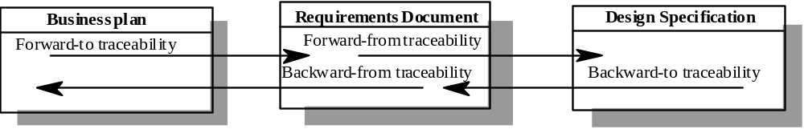

Slide 29

Requirements-sources traceability
  Links the requirement and the people or documents which specified the requirement
Requirements-rationale traceability
  Links the requirement with a description of why that requirement has been specified.
Requirements-requirements traceability
  Links requirements with other requirements which are, in some way, dependent on them. This should be a two-way link (dependants and is-dependent on).

Slide 30

Requirements-architecture traceability
  Links requirements with the sub-systems where these requirements are implemented. This is particularly important where sub-systems are being developed by different sub-contractors
Requirements-design traceability
  Links requirements with specific hardware or software components in the system which are used to implement the requirement
Requirements-interface traceability
  Links requirements with the interfaces of external systems which are used in the provision of the requirements

Slide 31

Traceability tables show the relationships between requirements or between requirements and design components
Requirements are listed along the horizontal and vertical axes and relationships between requirements are marked in the table cells
Traceability tables for showing requirements dependencies should be defined with requirement numbers used to label the rows and columns of the table

Slide 32

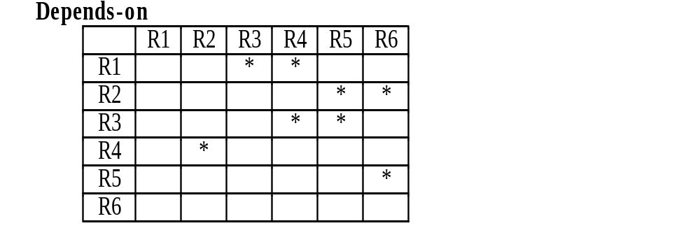

Slide 33

If a relatively small number of requirements have to be managed (up to 250, say), traceability tables can be implemented using a spreadsheet
Traceability tables become more of a problem when there are hundreds or thousands of requirements as the tables become large and sparsely populated
A simplified form of traceability table may be used where, along with each requirement description, one or more lists of the identifiers of related requirements are maintained.
Traceability lists are simple lists of relationships which can be implemented as text or as simple tables

Slide 34



Slide 35

Traceability policies define what and how traceability information should be maintained.
Traceability policies may include
  The traceability information which should be maintained.
  Techniques, such as traceability matrices, which should be used for maintaining traceability.
  A description of when the traceability information should be collected during the requirements engineering and system development processes.
  The roles of the people, such as the traceability manager, who are responsible for maintaining the traceability information should also be defined.
  A description of how to handle and document policy exceptions
  The process of managing traceability information

Slide 36

Number of requirements
  The greater the number of requirements, the more the need for formal traceability policies.
Estimated system lifetime
  More comprehensive traceability policies should be defined for systems which have a long lifetime.
Level of organisational maturity
  Detailed traceability policies are most likely to be cost-effective in organisations which have a higher level of process maturity

Slide 37

Project team size and composition
  With a small team, it may be possible to assess the impact of proposed informally without structured traceability information. With larger teams, however, you need more formal traceability policies.
Type of system
  Critical systems such as hard real-time control systems or safety-critical systems need more comprehensive traceability policies than non-critical systems.
Specific customer requirements
  Some customers may specify that specific traceability information should be delivered as part of the system documentation.

Slide 38
Requirements change is inevitable as customers develop a better understanding of their real needs and as the political, organisational and technical environment in which a system is to be installed changes.
Requirements which are concerned with the essence of a system are more likely to be stable than requirements which are more concerned with how the system is implemented in a particular environment.
Types of volatile requirement include mutable requirements, emergent requirements, consequential requirements and compatibility requirements.
Requirements management requires that each requirement should be uniquely identified.
If a large number of requirements have to be managed, the requirements should be stored in a database and links between related requirements should be maintained.

Slide 39

Change management policies should define the processes used for change management and the information which should be associated with each change request. They should also define who is responsible for doing what in the change management process.
Some automated support for change management should be provided. This may come through specialised requirements management tools or by configuring existing tools to support change management
Traceability information records the dependencies between requirements and the sources of these requirements, dependencies between requirements and dependencies between the requirements and the system implementation.
Traceability matrices may be used to record traceability information.
Collecting and maintaining traceability information is expensive. To help control these costs, organisations should define a set of traceability policies which set out what information is to be collected and how it is to be maintained.

Slide 40
One single Database for all projects
One dedicated module per project
Powerful Classification of requirements to support easy searching
Dynamic linking between requirements from different modules
It combines a database facility for storing requirements and high quality word processing for the text: cut, copy, paste, spell-checking, search, Pictures, Diagrams and Tables
Ability to define & save a “View” = particular Display of the data

Slide 41
Configuration Control via
  Maintenance of Software Change Requests
  Definition of Baseline
Export the content of a module to MS Word to generate the SRS document. “WEXP” freeware module has been integrated into RENATO
The usage of WEXP offers an improved version of the standard DOORS output. Example of requirement export:
DBS-FU-150-LPF
Need
Desirable
Priority
A
Traceability
OIRD
Target delivery
D1
Requirement
The user shall be able to request the import of the complete SDB
Explanation
Note that it is not required to support the import of ‘partial
’SDB versions.
Reuse
Yes

Slide 42
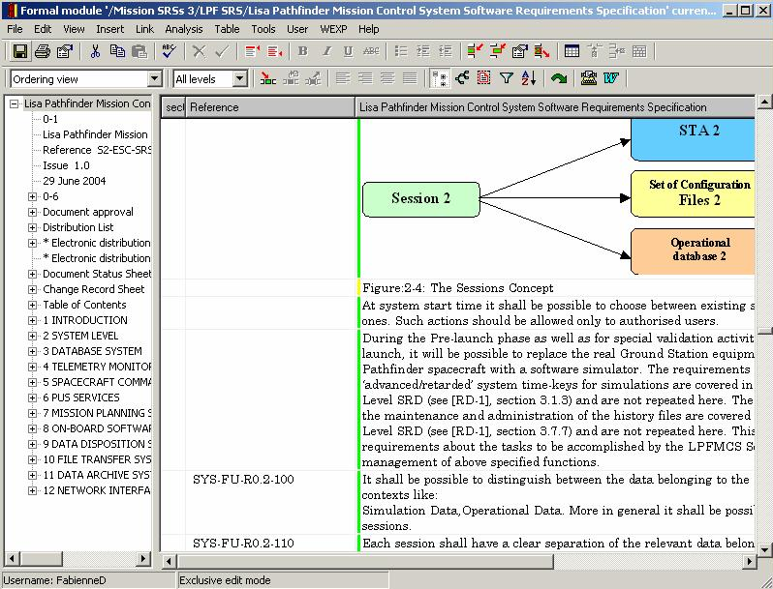
SRS
Chapters
Graphic
Text
Requirements

